Slide 1

Group 10: Final Project Presentation
Team Members:
Tejinderjeet Sandhu
Manuel Gavino
Jugen Fornoles
Ivan Calderon

Slide 2

Topic Chosen: Smash Bro’s Ultimate Tier List
Project Background:
1) Why Smash Bro’s Ultimate.
2) Design concept: Preface
3) Logical Design
4)Conceptual Front-End Use
5)Challenges
6)Coded Samples

Slide 3
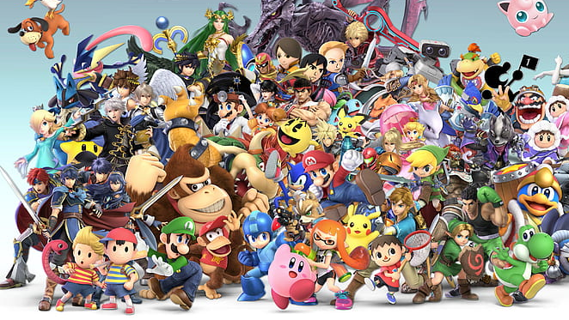
Why Super Smash Bro’s Ultimate
The game is known to be competitive and has skyrocket in popularity with Esports fans around the world since its first competitions started in 2002
This boom in popularity started a trend of websites with Tier List for the purpose of helping others enter the competitive scene or just learn how to counter characters when playing with friends
We ourselves as a team are either Esports fans or competitive player and felt it would be a good fit to help others enjoy and understand the competitive scene.
What we saw was that most current websites that provide a tier list for the game lacked key functions:
-basic character information
-social sharing of tier list
-Meta updates (Patch updates to keep game competitive)

Slide 4
Conceptual Design: Preface
For our project to work we had to determine what our entities would be and how they would be related with each other.
Our First attempt we had a total of 9 tables
With in those 9 tables we hade 65 Entities
2 tables where 2 total dependencies
Out of the 65 entitles We had 5 Primary Keys with no foreign keys
At this time the logical design had not been done so we expected an increase of tables and foreign keys.

Slide 5
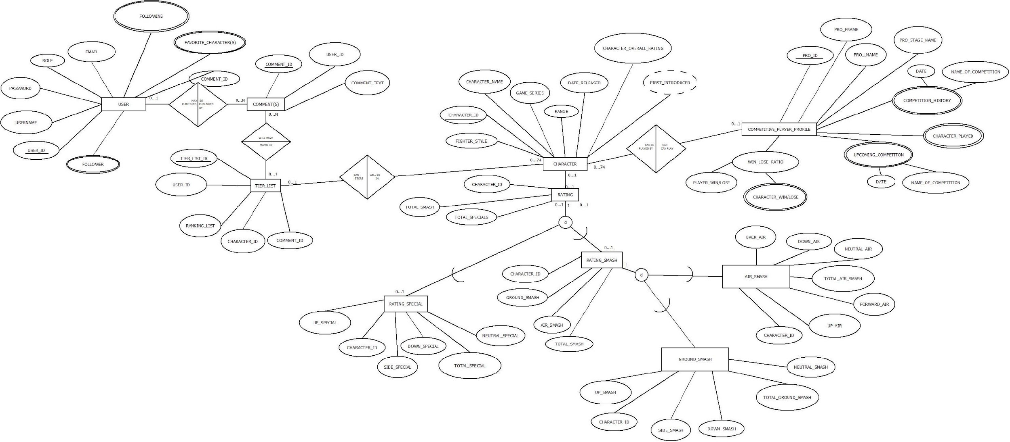
Conceptual Design: Preface continued
Our initial thoughts for the conceptual design:
-

Slide 6
Logical Design:
During this phase we:
- Looked back at our first attempt on the conceptual design for improvements to our initial submission
- We looked at the Function dependencies to make sure we didn’t miss any relationships
- We made sure our relational schema is in Boyce-Codd Normal Form (BCNF), which means that all redundancy based on functional dependency has been removed.
- Made Final revisions to our conceptual design and made an Enhanced ER Diagram to show how it all ties in

Slide 7
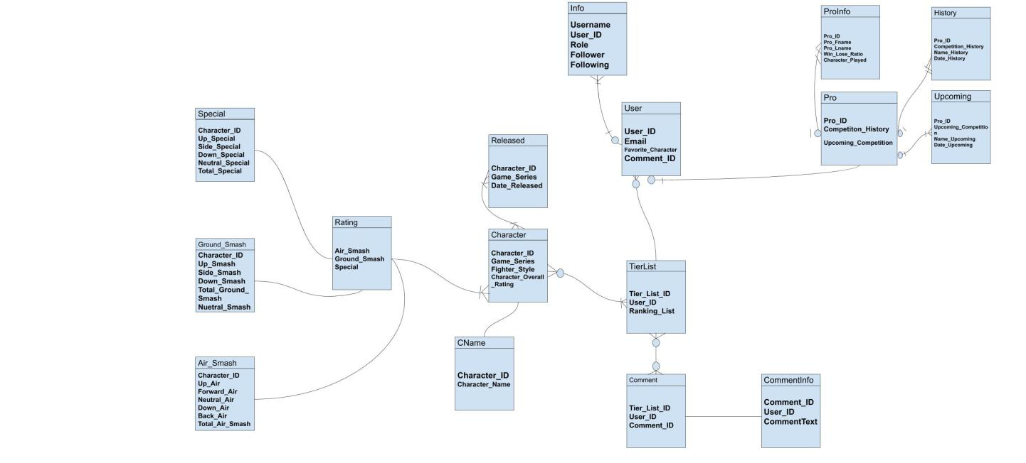
Examples: ERD

Slide 8
Conceptual Front-End Use:
Our Web site will run php commands that will allow the front end to access the backend database once a user is logged in to keep track of:
- Comments
∙ All users can comment on any tier list, but not no one user can delete any other user’s comments or keep track of other comments apart from theirs
- Tier list
∙ will be linked to the primary key: username
∙ this will make keeping track of tier list much easier than having a designated table do the sorting and management of tear list
∙ having front end handle modifying tier list will allow for reuse of rank list values
- search queries:
∙ users will be able to track tier list by other users they follow, search my character rank in a list, search by character name, search character bio
- Followers and followings
∙ user will be able to interact with each other by accessing the back end to following each others content, profile, tier list, and comment on other user tier list.

Slide 9
Challenges:
Triggers were one of the most challenging parts of the project that we had to work with
as we found out that you can’t change a table using a trigger
- We overcame this creating new seperate table that we could update.
With different schedules and other group project we had to find time to work as a group
- For the most part all member had availability at some point during the weekends and that was the time we were most productive.
We had to look at some extra SQL syntax terms that were not covered in class to make our code work as well as spend extra time on syntax that was briefly discussed such as constraints and triggers

Slide 10
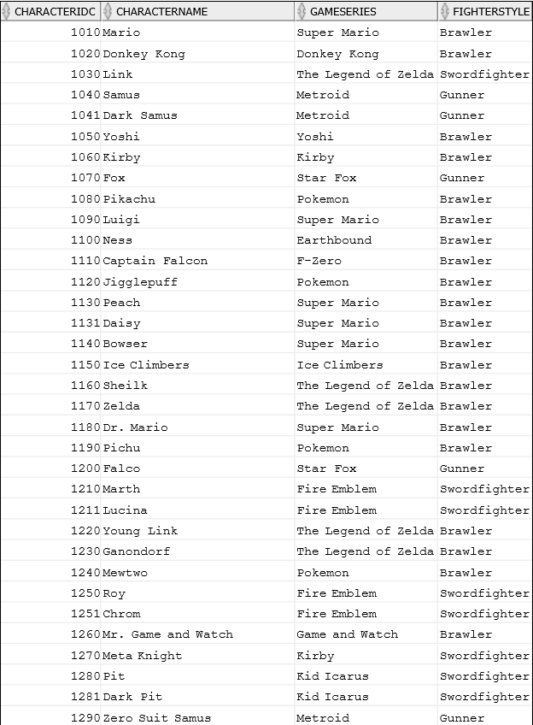
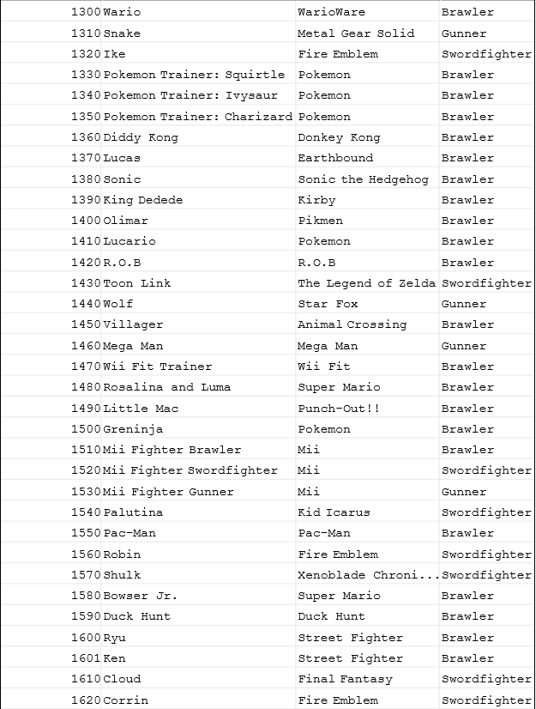
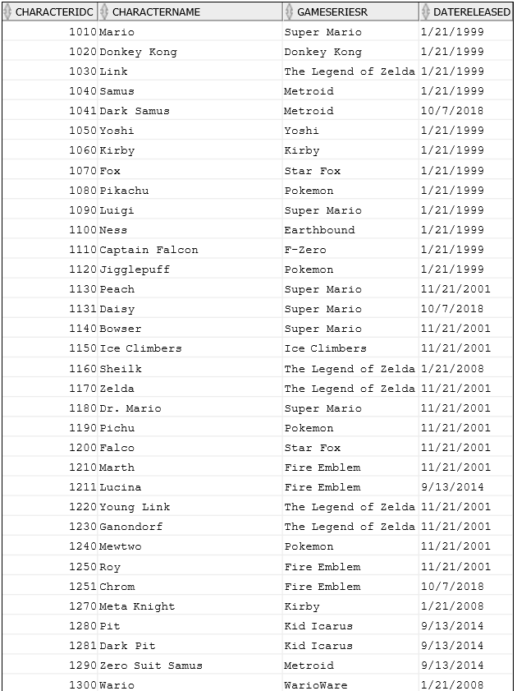
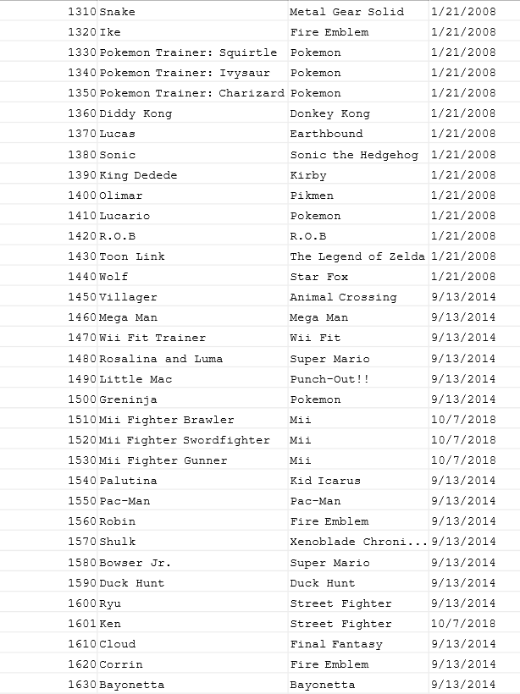
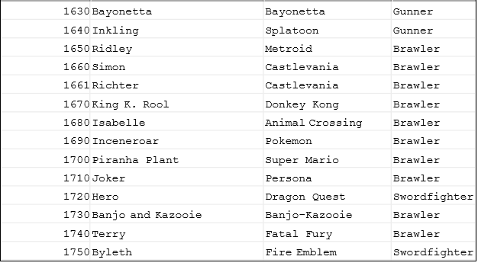
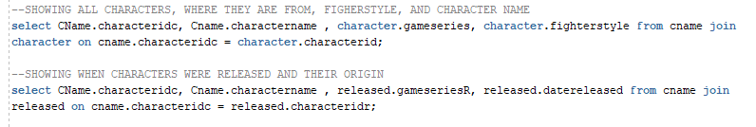
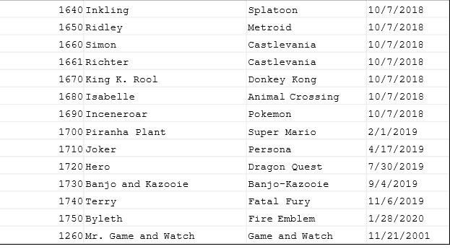

Slide 11
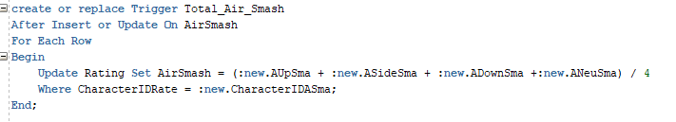
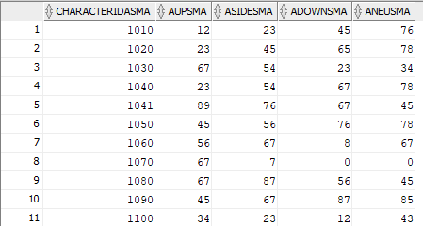
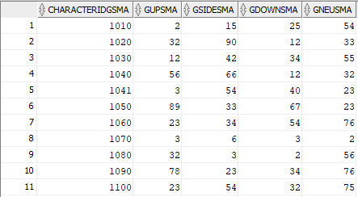
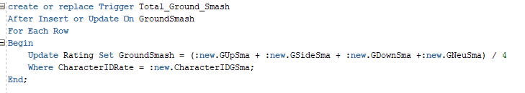
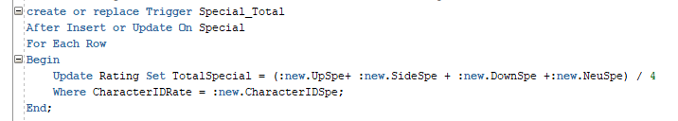
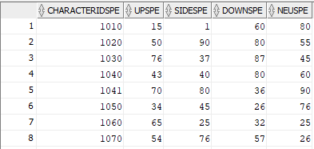
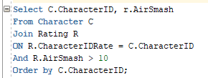
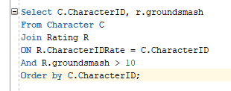




Slide 12
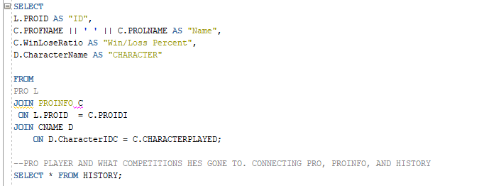
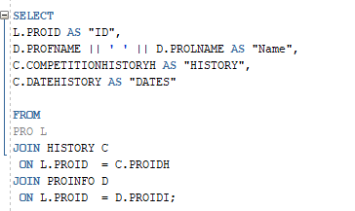


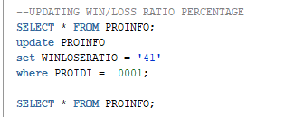

Slide 13
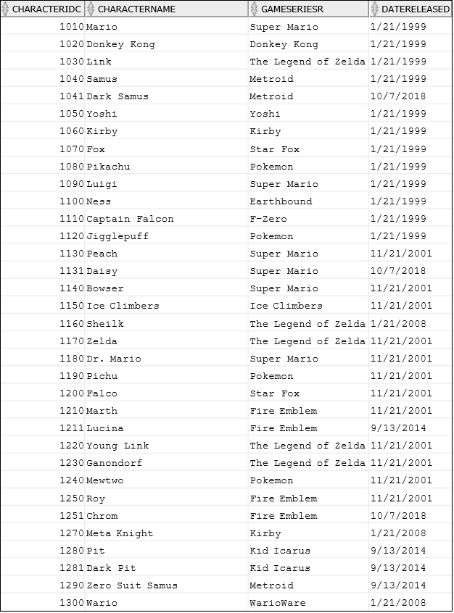
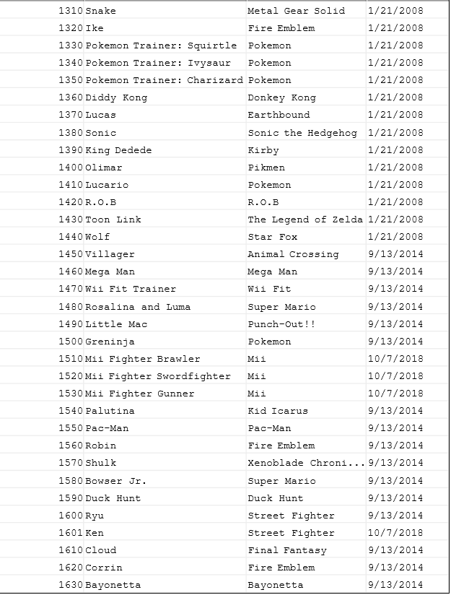
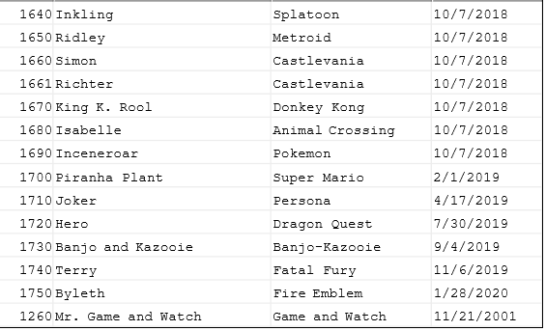

Slide 14





Slide 15
